Slide 1
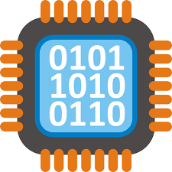
Floating Points, Range and Precision
Computer Organization

Slide 2


1. Intro
Lesson 2 Review
Floating Point Binary Fractions
Range and Precision
Higher Level Language Number - Java for example
Byte Order (Endianness)
Hexadecimal
Practice

Slide 3
Two’s Complement - Summary
Computers use two’s complement to represent negative numbers in binary
Half of the available combinations of bits are used to represent negative numbers
Notes:
1’s complement of a binary number is another binary number obtained by togglin all bits in it, i.e., transforming the 0 bit to 1 and the 1 bit to 0.
Examples:
g
Let numbers be stored using 4 bits
1's complement of 7 (0111) is 8 (1000)
1's complement of 12 (1100) is 3 (0011)
2’s complement of a binary number is 1 added to the 1’s complement of the binary number.
Examples:
Let numbers be stored using 4 bits
2's complement of 7 (0111) is 9 (1001)
2's complement of 12 (1100) is 4 (0100)
These representations are used for signed numbers.
The main difference between 1′ s complement and 2′ s complement is that 1′ s complement has two representations of 0 (zero) – 00000000, which is positive zero (+0) and 11111111, which is negative zero (-0); whereas in 2′ s complement, there is only one representation for zero – 00000000 (+0) because if we add 1 to 11111111 (-1), we get 00000000 (+0) which is the same as positive zero. This is the reason why 2′ s complement is generally used.
Another difference is that while adding numbers using 1′ s complement, we first do binary addition, then add in an end-around carry value. But, 2′ s complement has only one value for zero, and doesn’t require carry values.

Slide 4
Binary Addition

Slide 5
8 bits addition
128 | 64 | 32 | 16 | 8 | 4 | 2 | 1
1
1
0111 0000
0010 1010
112
42
1001 1010
154

Slide 6
8 bits addition - overflow
128 | 64 | 32 | 16 | 8 | 4 | 2 | 1
1 1 1 1 1 1 1
1011 0110
0111 1010
182
122
x
0011 0000
304

Slide 7
Binary Subtraction

Slide 8
8 bits subtraction
128 | 64 | 32 | 16 | 8 | 4 | 2 | 1
0 1 1 2
0111 0000
- 0010 1010
112
- 42
0100 0110
70

Slide 9
Fixed Point Binary Fractions

Slide 10
8 bits with 3 bits precision
16 | 8 | 4 | 2 | 1 | .5 | .25 | .125
1 | 0 | 1 | 1 | 0 | 0 | 1 | 1
binary point
16 + 4 + 2 + .25 + .125 = 22.375

Slide 11
12 bits with 4 bits precision
128 | 64 | 32 | 16 | 8 | 4 | 2 | 1 | .5 | .25 | .125 | .0625
1 | 0 | 1 | 1 | 0 | 1 | 0 | 0 | 1 | 0 | 0 | 1
binary point
128 + 32 + 16 + 4 + .5 +.0625 = 180.5625

Slide 12
Two’s complement 12 bits with 4 bits precision
-128 | 64 | 32 | 16 | 8 | 4 | 2 | 1 | .5 | .25 | .125 | .0625
1 | 0 | 0 | 1 | 1 | 0 | 1 | 1 | 0 | 1 | 1 | 0
binary point
-128 + 16 + 8 + 2 + 1 + .25 +.125 = -100.375
Notes:
1.1112

Slide 13
Practice

Slide 14
Each binary number is stored using two’s complement. Convert to decimal
101001011000
010111011100
001001010110
Notes:
101001011000₂ = -90.5₁₀
010111011100₂ = 93.75₁₀
001001010110₂ = 37.375

Slide 15
Using two’s complement, convert into fixed point binary. Result should be in 12 bits with 4 bits after the binary point
13.5
-86.75
-1.5
Notes:
13.5₁₀ = 000011011000₂
-86.75 = 101010101100₂
-1.5 = 111111101000₂

Slide 16
Two’s complement 12 bits with 4 bits precision
-128 | 64 | 32 | 16 | 8 | 4 | 2 | 1 | .5 | .25 | .125 | .0625
1 | 0 | 1 | 0 | 1 | 0 | 1 | 0 | 1 | 1 | 0 | 0
binary point
-128 + 32 + 8 + 2 + .5 +.25 = -85.25
Notes:
-85.25 101010101100₂

Slide 17
Summary
Fixed point binary is used in Digital Signal Processing
Simpler and therefore cheaper processor hardware
Greatly simplified arithmetic means much faster processing
Trade off between range and precision
Some numbers can never be represented accurately
Used in real time application when performance is more important than accuracy

Slide 18
Floating Point Binary Fractions
Notes:
Most modern computer use floating point to represent real numbers.
Why? Because floating point binary makes particular efficient use of the computer hardware.
Representing extremely large, small or values that require high degree of precision

Slide 19
Expressing values using
Scientific Notation
300 = 3.0 × 10²
0.2 = 2.0 × 10⁻¹
987 = 9.87 × 10²
Notes:
Scientific notation is a way of expressing numbers that are too large or too small (usually would result in a long string of digits) to be conveniently written in decimal form. It may be referred to as scientific form or standard index form, or standard form in the UK. This base ten notation is commonly used by scientists, mathematicians, and engineers, in part because it can simplify certain arithmetic operations. On scientific calculators it is usually known as "SCI" display mode.
In scientific notation, nonzero numbers are written in the form
m × 10^{n}

Slide 20
Standard Scientific Notation using positive exponent
mantissa
exponent
2.99 × 10⁸
m × 10^{n}
299000000.
Notes:
Speed of light in a vacuum measured in meter per second
299 million meters per second
The more digits in the mantissa we can express values with greater precision
The number of digits written in the mantissa govern the precision
The number of digits written in the exponent govern the range

Slide 21
Standard Scientific Notation using negative exponent
mantissa
exponent
1.60 × 10⁻¹⁹
0.000000000000000000160
Notes:
Charge on a electron
This is a very small fraction

Slide 22
Floating point inside the computer
mantissa
exponent
 |  |  |  |  |  |  |  |  |  | -32 | 16 | 8 | 4 | 2 | 1
0 | 1 | 0 | 1 | 0 | 1 | 0 | 0 | 0 | 0 | 0 | 0 | 0 | 0 | 1 | 0
imaginary point
sign bit
sign bit
0 | 1 | 0 | 1 | 0 | 1 | 0 | 0 | 0 | 0
x 2²
2 | 1 | .5 | .25 | .125
1 | 0 | 1 | 0 | 1
2 + .5 + .125 = 2.625
Notes:
16 bits register
10 bits dedicate to the mantissa
6 bits dedicated to the exponent
Two’s complement used in both
IEEE standard

Slide 23
Practice

Slide 24
Convert floating point binary to decimal. Assume 10 bits mantissa and 6 bits exponent, both two’s complement
0110110100000010
0101100000111111
Notes:
0110110100000010₂ = 3.40625₁₀
0101100000111111₂ = 0.34375₁₀

Slide 25
Range and Precision

Slide 26
Standard Scientific Notation
mantissa
exponent
 |  |  |  |  |  |  |  |  |  | -32 | 16 | 8 | 4 | 2 | 1
0 | 0 | 1 | 1 | 1 | 1 | 1 | 0 | 1 | 0 | 0 | 0 | 1 | 0 | 0 | 0
imaginary point
sign bit
sign bit
Notes:
The mantissa of a floating point number holds the detail of the value of a number, while the exponent is used as a positive or negative factor that can increase or decrease the magnitude of the number. Hence, increasing the number of bits used for the mantissa results in more precision, while increasing the number of bits used for the exponent allows a wider range of available numbers. Consequently, if we need to store precise fractional numbers, we need to have many bits available for the mantissa, while if we want to store very large or very small numbers we need to have many bits available for the exponent.
mantissa => detail of the value of a number represented => increasing bits results in more precision
exponent => increase or decrease the magnitude of the number => increasing bits results in wider range of available numbers

Slide 27
Representing Number Values in Higher Level Language like Java
byte | 8-bit signed two's complement integer (-128 to 127)
short | 16-bit signed two's complement integer (-32,768 to 32767)
int | 32-bit signed two's complement integer (-2³¹ to 2³¹-1)
long | 64-bit signed two's complement integer (-2⁶³ to 2⁶³-1)
float | single-precision 32-bit IEEE 754 floating point (23 bits mantissa + 8 bits exponent)
double | double-precision 64-bit IEEE 754 floating point (52 bits mantissa + 11 bits exponent)
BigDecimal | Complete control over rounding behavior (Use for Currency)
Notes:
byte: The byte data type is an 8-bit signed two's complement integer. It has a minimum value of -128 and a maximum value of 127 (inclusive). The byte data type can be useful for saving memory in large arrays, where the memory savings actually matters. They can also be used in place of int where their limits help to clarify your code; the fact that a variable's range is limited can serve as a form of documentation.
short: The short data type is a 16-bit signed two's complement integer. It has a minimum value of -32,768 and a maximum value of 32,767 (inclusive). As with byte, the same guidelines apply: you can use a short to save memory in large arrays, in situations where the memory savings actually matters.
int: By default, the int data type is a 32-bit signed two's complement integer, which has a minimum value of -2³¹ and a maximum value of 2³¹-1. In Java SE 8 and later, you can use the int data type to represent an unsigned 32-bit integer, which has a minimum value of 0 and a maximum value of 2³²-1. Use the Integer class to use int data type as an unsigned integer. See the section The Number Classes for more information. Static methods like compareUnsigned, divideUnsigned etc have been added to the Integer class to support the arithmetic operations for unsigned integers.
long: The long data type is a 64-bit two's complement integer. The signed long has a minimum value of -2⁶³ and a maximum value of 2⁶³-1. In Java SE 8 and later, you can use the long data type to represent an unsigned 64-bit long, which has a minimum value of 0 and a maximum value of 2⁶⁴-1. Use this data type when you need a range of values wider than those provided by int. The Long class also contains methods like compareUnsigned, divideUnsigned etc to support arithmetic operations for unsigned long.
float: The float data type is a single-precision 32-bit IEEE 754 floating point. Its range of values is beyond the scope of this discussion, but is specified in the Floating-Point Types, Formats, and Values section of the Java Language Specification. As with the recommendations for byte and short, use a float (instead of double) if you need to save memory in large arrays of floating point numbers. This data type should never be used for precise values, such as currency. For that, you will need to use the java.math.BigDecimal class instead. Numbers and Strings covers BigDecimal and other useful classes provided by the Java platform.
double: The double data type is a double-precision 64-bit IEEE 754 floating point. Its range of values is beyond the scope of this discussion, but is specified in the Floating-Point Types, Formats, and Values section of the Java Language Specification. For decimal values, this data type is generally the default choice. As mentioned above, this data type should never be used for precise values, such as currency.

Slide 28
Range and Precision - Summary
For a given sized register, the number of values that can be represented is limited
Greater precision comes at the expense of range
Greater range comes at the expense of precision
Accuracy often depends on precision, but not always
There will always be values that can’t be represented accurately in binary

Slide 29
Byte Order (Endianness)
Notes:
In computing, endianness is the order or sequence of bytes of a word of digital data in computer memory. Endianness is primarily expressed as big-endian (BE) or little-endian (LE). little-endian system, in contrast, stores the least-significant byte at the smallest address.smallest memory address and the least significant byte at the largest. A little-endian system, in contrast, stores the least-significant byte at the smallest address.
Endianness may also be used to describe the order in which the bits are transmitted over a communication channel, e.g., big-endian in a communications channel transmits the most significant bits first.[1] Bit-endianness is seldom used in other contexts.

Slide 30
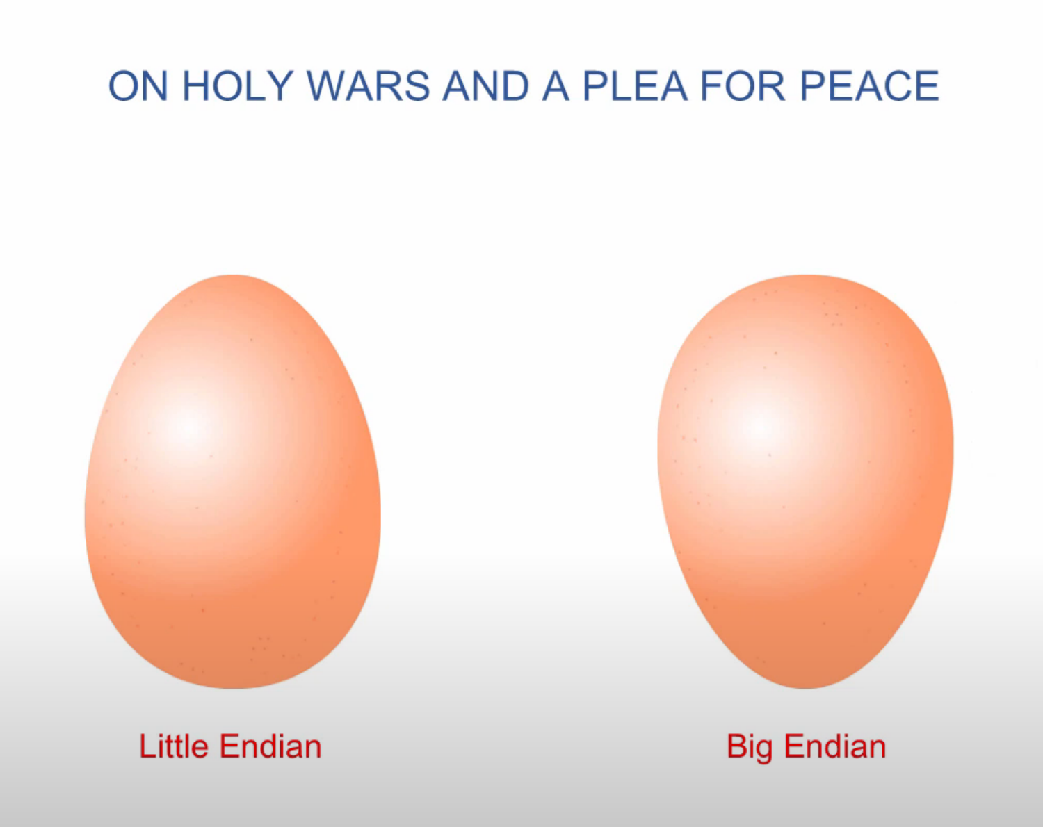
Notes:
Many historical and extant processors use a big-endian memory representation, either exclusively or as a design option. Big-endian memory representation is commonly referred to as network order, as used in the Internet protocol suite. Other processor types use little-endian memory representation; others use yet another scheme called "middle-endian", "mixed-endian" or "PDP-11-endian".
The IBM System/360 uses big-endian byte order, as do its successors System/370, ESA/390, and z/Architecture. The PDP-10 also uses big-endian addressing for byte-oriented instructions. The IBM Series/1 minicomputer also use big-endian byte order.
Dealing with data of different endianness is sometimes termed the NUXI problem.^{[10]} This terminology alludes to the byte order conflicts encountered while adapting UNIX, which ran on the mixed-endian PDP-11, to a big-endian IBM Series/1 computer. Unix was one of the first systems to allow the same code to be compiled for platforms with different internal representations. One of the first programs converted was supposed to print out Unix, but on the Series/1 it printed nUxi instead.^{[11]}
The Datapoint 2200 uses simple bit-serial logic with little-endian to facilitate carry propagation. When Intel developed the 8008 microprocessor for Datapoint, they used little-endian for compatibility. However, as Intel was unable to deliver the 8008 in time, Datapoint used a medium scale integration equivalent, but the little-endianness was retained in most Intel designs, including the MCS-48 and the 8086 and its x86 successors.^{[12][13]} The DEC Alpha, Atmel AVR, VAX, the MOS Technology 6502 family (including Western Design Center 65802 and 65C816), the Zilog Z80 (including Z180 and eZ80), the Altera Nios II, and many other processors and processor families are also little-endian.
The Motorola 6800 / 6801, the 6809 and the 68000 series of processors used the big-endian format.
The Intel 8051, contrary to other Intel processors, expects 16-bit addresses for LJMP and LCALL in big-endian format; however, xCALL instructions store the return address onto the stack in little-endian format.^{[14]}
SPARC historically used big-endian until version 9, which is bi-endian; similarly early IBM POWER processors were big-endian, but the PowerPC and Power ISA descendants are now bi-endian. The ARM architecture was little-endian before version 3 when it became bi-endian.
Current architectures[edit]
The Intel x86 and AMD64 / x86-64 series of processors use the little-endian format. Other instruction set architectures that follow this convention, allowing only little-endian mode, include Nios II, Andes Technology NDS32, and Qualcomm Hexagon.
Some instruction set architectures allow running software of either endianness on a bi-endian architecture. This includes ARM AArch64, C-Sky, Power ISA, and RISC-V.
Solely big-endian architectures include the IBM z/Architecture, Freescale ColdFire (which is Motorola 68000 series-based), Atmel AVR32, and OpenRISC. The IBM AIX and Oracle Solaris operating systems on bi-endian Power ISA and SPARC run in big-endian mode; some distributions of Linux on Power have moved to little-endian mode.

Slide 31
Decimal Positional Notation
Most significant number on the left.
Biggest part of the number that is the BIG END
1000 | 100 | 10 | 1
1 | 0 | 2 | 4
1 | 10 | 100 | 1000
4 | 2 | 0 | 1
Most significant number on the right.
Littlest part of the number, that is the LITTLE END

Slide 32
Binary Positional Notation
Most significant number on the left.
Biggest part of the number that is the BIG END
8 | 4 | 2 | 1
1 | 1 | 1 | 0
1 | 2 | 4 | 8
0 | 1 | 1 | 1
Most significant number on the right.
Littlest part of the number, that is the LITTLE END
Notes:
1110 => 14 <* BIG ENDIAN machine thinks this is number 14 *>
1110 => 7 <* LITTLE ENDIAN machine think this is number 7 *>

Slide 33
Binary Positional Notation
128 | 64 | 32 | 16 | 8 | 4 | 2 | 1
0 | 0 | 1 | 0 | 1 | 1 | 1 | 0
0 | 1 | 0 | 0 | 1 | 1 | 1 | 0
0 | 0 | 0 | 1 | 0 | 1 | 0 | 0
1 | 1 | 1 | 0 | 0 | 0 | 1 | 0
1 | 0 | 1 | 0 | 0 | 1 | 0 | 0

Slide 34
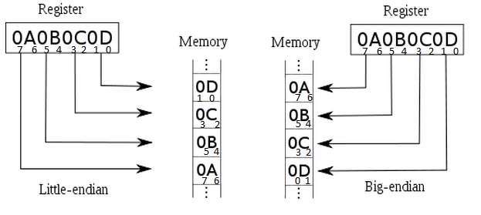

Slide 35
Hexadecimal
Notes:
In mathematics and computing, the hexadecimal (also base 16 or hex) numeral system is a positional numeral system that represents numbers using a radix (base) of 16. Unlike the common way of representing numbers using 10 symbols, hexadecimal uses 16 distinct symbols, most often the symbols "0"–"9" to represent values 0 to 9, and "A"–"F" (or alternatively "a"–"f") to represent values 10 to 15.
Hexadecimal numerals are widely used by computer system designers and programmers because they provide a human-friendly representation of binary-coded values. Each hexadecimal digit represents four bits (binary digits), also known as a nibble (or nybble), which is 1/2 of a byte. For example, a single byte can have values ranging from 00000000 to 11111111 in binary form, which can be conveniently represented as 00 to FF in hexadecimal.

Slide 36
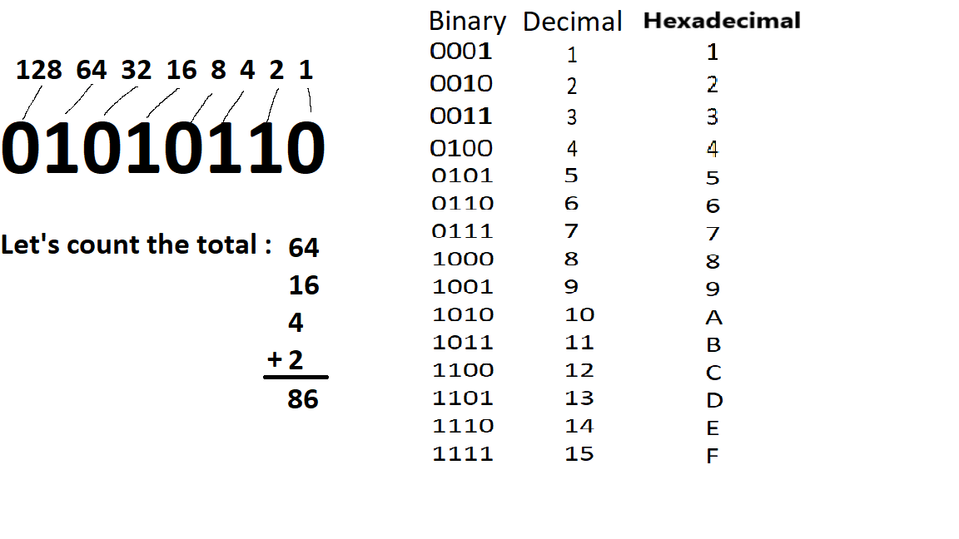
Notes:
#FFFFFF
255 255 255

Slide 37
2. End
HOMEWORK ***
Collaborate on Slack
Floating Points, Hex, Range Precision
Complete practice problems
Download Logisim-evolution
Test that you are able to run on your computer.

